Slide 1
A GUIDEBOOK TO IOS
JAILBREAKING
By: Noah Hendricks
CIS 3351

Slide 2
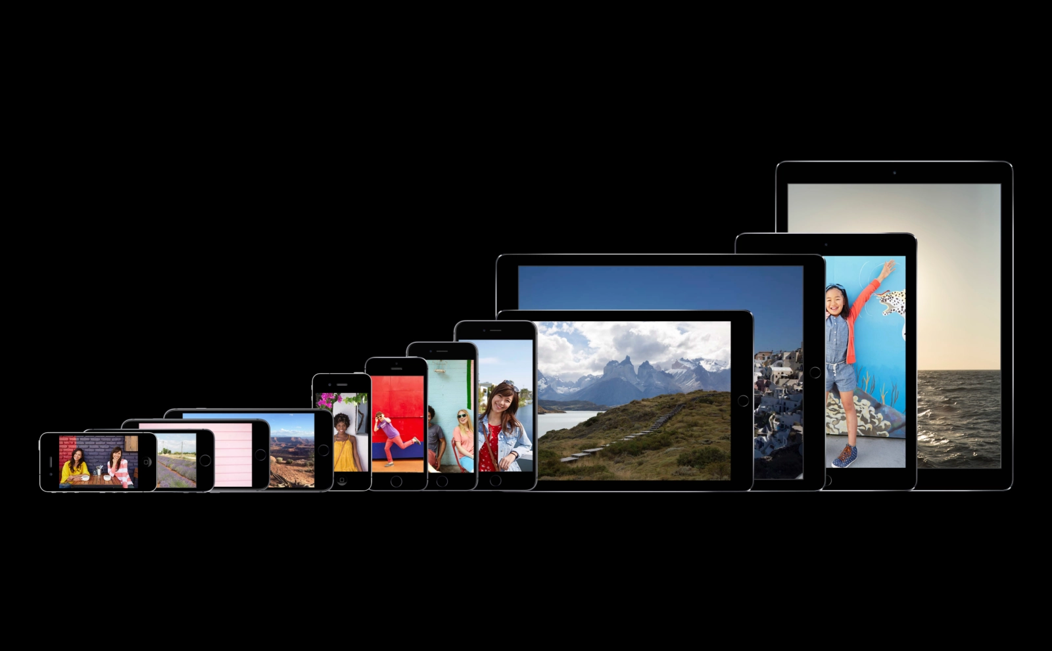
INTRODUCTION
IOS Devices include iPhones, iPads & iPod Touch
Everything to know about jailbreaking your IOS Devices
MacBook's & Apple TV’s can also be jailbroken but they have different operating systems

Slide 3
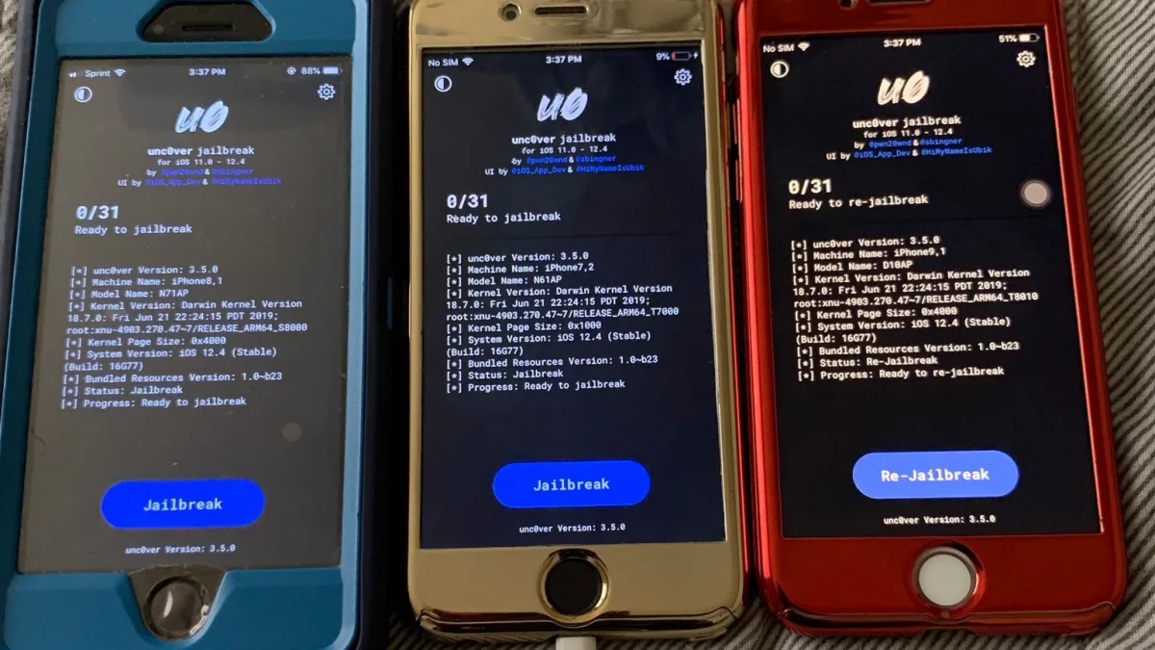
WHAT IS JAILBREAKING?
Freeing your device of all rules and restrictions from current software
Also disregards any policies or instruction sets from Apple or phone carriers
It allows accessibility to special features that was originally prohibited

Slide 4
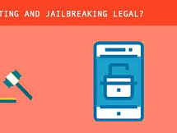
Legality of Jailbreaking
Jailbreaking IOS Devices is totally LEGAL in the U.S.
Is illegal in other countries
There are guidelines to this however

Slide 5
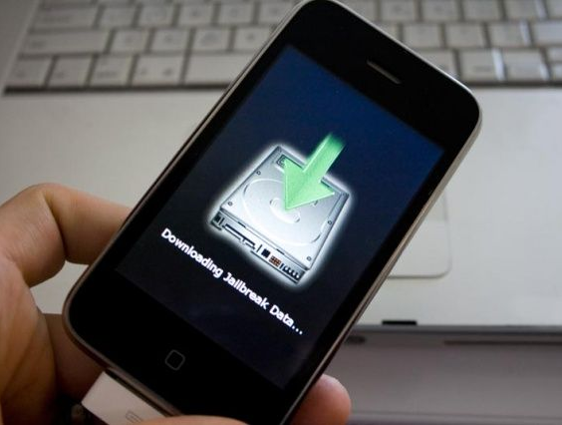
IOS JAILBREAK HISTORY
The First IOS Jailbreak occurred in 2007
It was done by 17-year-old male George Hotz
Only used a screwdriver and guitar pick

Slide 6
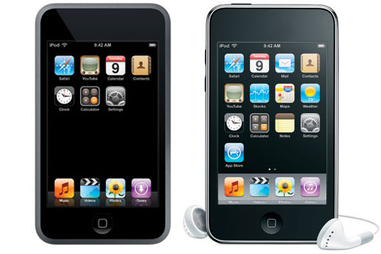
PERSONAL EXPERIENCE
I jailbroke the original iPod Touch
It was super cool and fun at first
After some time, my device was very unstable & unreliable

Slide 7
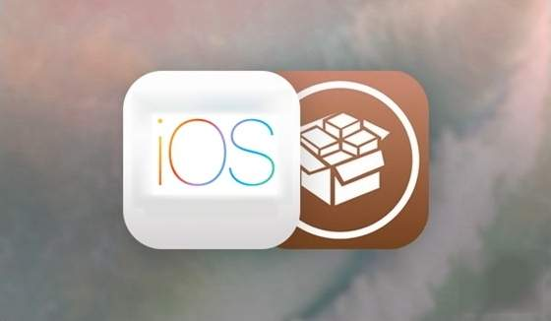
JAILBREAK PROS
Download and Use of Third-Party apps
Cross Compatible File Sharing
Special Customization of IOS Device
Remove Pre-Installed Apps

Slide 8
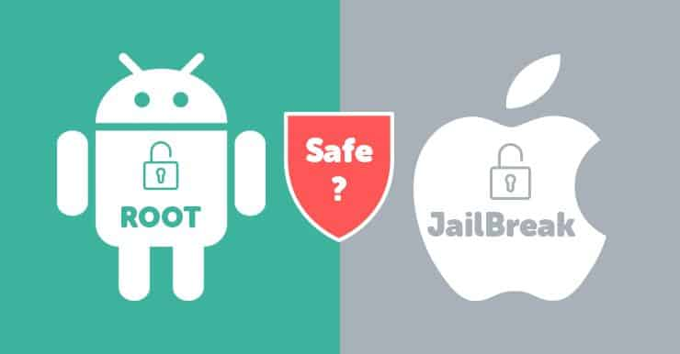
JAILBREAK CONS
Invalidate iPhone warranty
Apple’s software security is terminated
Inability to update IOS Device
Drained battery life
Increased Device crash rate
Disruption of services

Slide 9
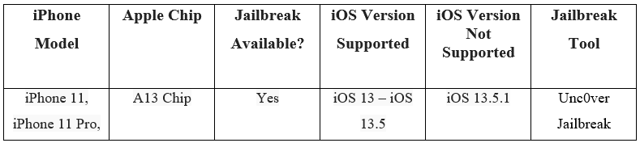
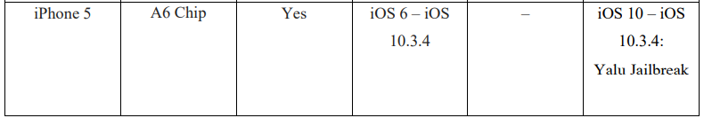
Jailbreak Instructions
There is different software to use depending on the version of your IOS Device

Slide 10

STEP BY STEP GUIDE
3 Key steps to jailbreak your IOS Device
Jailbreak at your own risk
Step 1: Gather IOS Device & Install AltStore
Step 2: Install the jailbreak tool software required by the version of your device
Step 3: Launch the Cydia App from your IOS home screen and enjoy your jailbroken device!

Slide 11
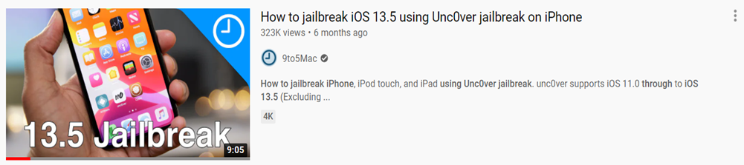
YOUTUBE ATTACHMENT
9to5Mac’s You Tube Tutorial
Link: https://www.youtube.com/watch?v=pN-OazsEcEQ

Slide 12

CONCLUSION
Although jailbreaking an IOS device is very entertaining and fun, I would NOT recommend it
The cons indefinitely outweigh the pros
It’s ultimately the user’s choice, but it is a very risky process that could harm your device forever

Slide 13
REFERENCES
“Disadvantages & Benefits of Jailbreaking IOS.” Should I Jailbreak My IPhone? Reasons to or Not to Jailbreak IPhone, IPad, IPod, Anvsoft Inc, Retrieved November 28, 2020, from www.syncios.com/iphone/should-i-jailbreak-my-iphone.html.
Heath, Alex. “The History Of Jailbreaking [Feature].” Cult of Mac, 27 July 2015, Retrieved November 28, 2020, from
www.cultofmac.com/192850/the-history-of-jailbreaking-feature/.
“How to Jailbreak IPhone, IPad and IPod Touch.” IPhone Hacks | #1 IPhone, IPad, IOS Blog, Blog Consulting, 7 June 2020, Retrieved November 28, 2020, from www.iphonehacks.com/jailbreak.
“Jailbreak: What Is Involved in Advanced User Access to IOS Devices?” IONOS Digitalguide, 1 & 1 IONOS Inc, 2 Mar. 2020, Retrieved November 28, 2020, from www.ionos.com/digitalguide/websites/web-development/jailbreak-ios/.
Johansen, Alison Grace. “Is Jailbreaking Legal and Safe?” Norton, NortonLifeLockInc, 22 Mar. 2019, Retrieved November 28, 2020, from
us.norton.com/internetsecurity-mobile-is-jailbreaking-legal-and-safe.html.
Mead-Green, Rob. “The Pros and Cons of IPhone Jailbreaking.” Macworld UK, IDG, 27 Feb. 2018, Retrieved November 28, 2020, from
www.macworld.co.uk/feature/is-jailbreaking-my-iphone-or-ipad-safe-3491721/.
Nazario, Kyle. “An Introduction to Jailbreaking for Total Beginners.” TechNorms, TechNorms, 27 Feb. 2019, Retrieved November 28, 2020, from
www.technorms.com/11357/introduction-jailbreaking-total-beginners.
Sachdeva, Anmol. “What Is Jailbreaking? Is Jailbreaking An IPhone Illegal?” Fossbytes, Fossbyte Media Pvt Ltd, 14 Dec. 2018, Retrieved November 28, 2020, from fossbytes.com/what-is-jailbreaking-iphone-illegal/.
“Unauthorized Modification of IOS Can Cause Security Vulnerabilities, Instability, Shortened Battery Life, and Other Issues.” Apple Support, Apple Inc, 15 June 2018, Retrieved November 28, 2020, from support.apple.com/en-us/HT201954.
YouTube Tutorial by 9to5Mac’s, Retrieved November 28, 2020, from
https://www.youtube.com/watch?v=pN-OazsEcEQ

